Slide 1
8th International Workshop on Camera Based Document Image Analysis & Recognition
https://cbdar2019.univ-lr.fr
Endorsed by:
With the support of:

Slide 2
Organizers:
Lluis Gomez-Bigorda
Muhammad Muzzamil Luqman
https://cbdar2019.univ-lr.fr
@cbdar_workshop
Endorsed by:
With the support of:

Slide 3
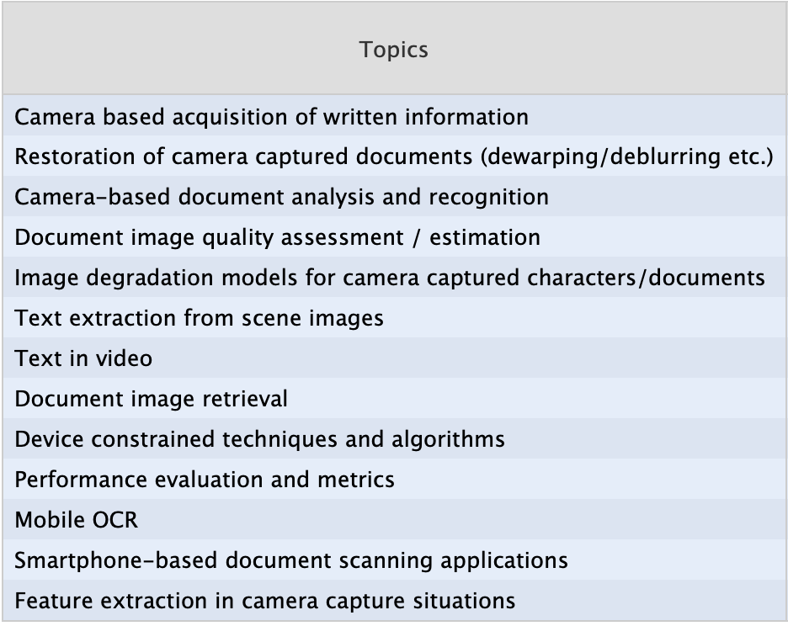
Workshop Statistics
Received submissions: 14-1
Accepted: 10
Acceptance rate: 70%
9 different countries:
Australia, Brazil, Canada, China,
France, India, Spain, Russia, USA
Endorsed by:
With the support of:

Slide 4
Technical program
https://cbdar2019.univ-lr.fr/technical-program/
Endorsed by:
With the support of:

Slide 5
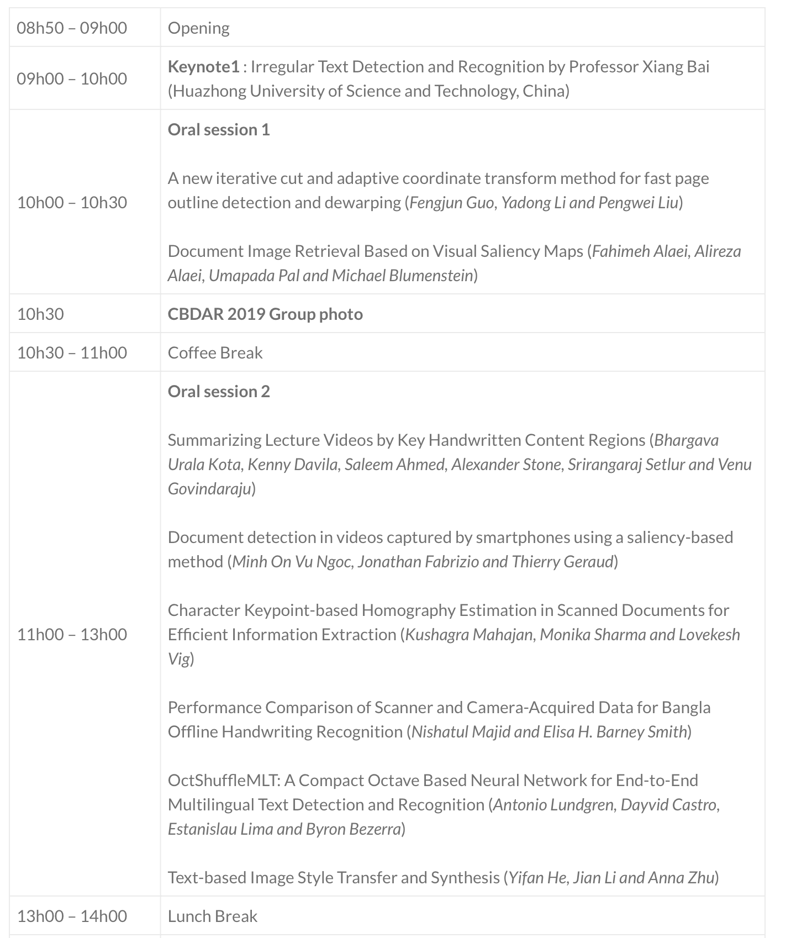
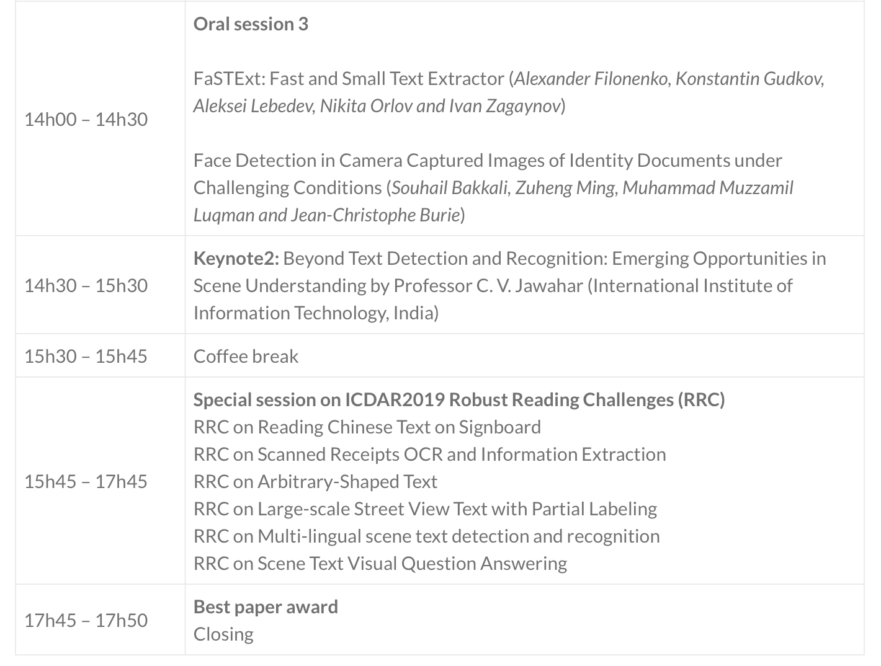
Technical program
Endorsed by:
With the support of:

Slide 6
Keynote Speakers
Irregular Text Detection and Recognition
Professor Xiang Bai
Huazhong University of Science and Technology, China
Beyond Text Detection and Recognition: Emerging Opportunities in Scene Understanding
Professor C. V. Jawahar
International Institute of Information Technology, India
Endorsed by:
With the support of:

Slide 7
People
Workshop Chairs/Organizers
Lluis Gomez-Bigorda (Computer Vision Centre, Spain)
Muhammad Muzzamil Luqman (L3i Laboratory, La Rochelle University, France)
Programme Committee
Anna Zhu (Computer Science & Tech, Wuhan University of Technology, China)
Basilis Gatos (NCSR Demokritos, Greece)
Cheng-Lin Liu (Chinese Academy of Sciences, China)
C.V. Jawahar (IIIT, India)
Dimosthenis Karatzas (Computer Vision Centre, Spain)
Ernest Valveny (Computer Vision Centre, Spain)
Faisal Shafait (NUST, Islamabad, Pakistan)
Gaofeng Meng (Chinese Academy of Sciences, China)
Jerod Weinman (Grinnell College, USA)
Joseph Chazalon (EPITA Research and Development Laboratory, EPITA, France)
Lukas Neumann (Visual Geometry Group, University of Oxford, England)
Marçal Rusinyol (Computer Vision Centre, Spain)
Masakazu Iwamura (Osaka Prefecture University, Japan)
Michael Blumenstein (University of Technology Sydney, Australia)
Mickael Coustaty (L3i Laboratory, La Rochelle University, France)
Nibal Nayef (MyScript, Nantes, France)
Syed Saqib Bukhari (DFKI, Germany)
Petra Gomez-Krämer (L3i Laboratory, La Rochelle University, France)
Umapada Pal (ISI, India)
Xiang Bai (Huazhong University of Science and Technology, China)
Special thanks to:
Elisa H. Barney Smith (Boise State University, USA)
Kais Rouis (L3i Laboratory, La Rochelle University, France)
Melissa Cote (University of Victoria, Canada)
Quoc Bao Dang (L3i Laboratory, La Rochelle University, France)
Zuheng Ming (L3i Laboratory, La Rochelle University, France)
Endorsed by:
With the support of:

Slide 8
Best Paper Award
CBDAR 2019’s Best Paper Award will be announced during the closing session
Endorsed by:
With the support of:

Slide 9
Enjoy the workshop
Organizers:
Lluis Gomez-Bigorda
Muhammad Muzzamil Luqman
https://cbdar2019.univ-lr.fr
@cbdar_workshop
Endorsed by:
With the support of:

Slide 10
1st Keynote Talk
Irregular Text Detection and Recognition
Professor Xiang Bai
Huazhong University of Science and Technology, China
Endorsed by:
With the support of:

